Slide 1
FRONTEND DEVELOPMENT
Submitted By : Baggam Sai Karthik
Registration No:11906091

Slide 2
OBJECTIVES
The main objective of this training is to learn the basic concepts of Frontend web development.
To develop skills in the designing of the website with an attractive look.
To learn the importance of the Html and Css while designing the website.
To design a basic website with the help of the HTML, CSS, JavaScript
Creating an own website with the help HTML, CSS and JavaScript.

Slide 3
INTRODUCTION
Hyper Text Markup Language (HTML) is a standard markup language for creating the webpages and web applications .
The main use of the html is to describe the structure of the web pages as it consists a series of elements in it.
CSS is the language we use to style a HTML document. The full form of the CSS is Cascading Style Sheets. CSS is designed to make style sheets for the web.
JavaScript is a lightweight, cross-platform, and interpreted scripting language. JavaScript can be used for Client-side developments as well as Server-side developments.

Slide 4
OBJECTIVES OF THE PROJECT
To develop an easy to use web based interface where users can search for products, and order the products.
An user can view the complete specification of the product along with the various images
Online shopping is the process whereby consumers directly buy goods , services etc. from a seller interactively in real time without an intermediary service over the internet.

Slide 5
User operations
User Signup : A User can signup himself/herself to appear in the Any shopping and may login with his/her given username and password.
User’s Login : User can do shopping by entering his/her username and password.
Buy Now : The facility provide to user that he can choose the which he wants to purchase.

Slide 6
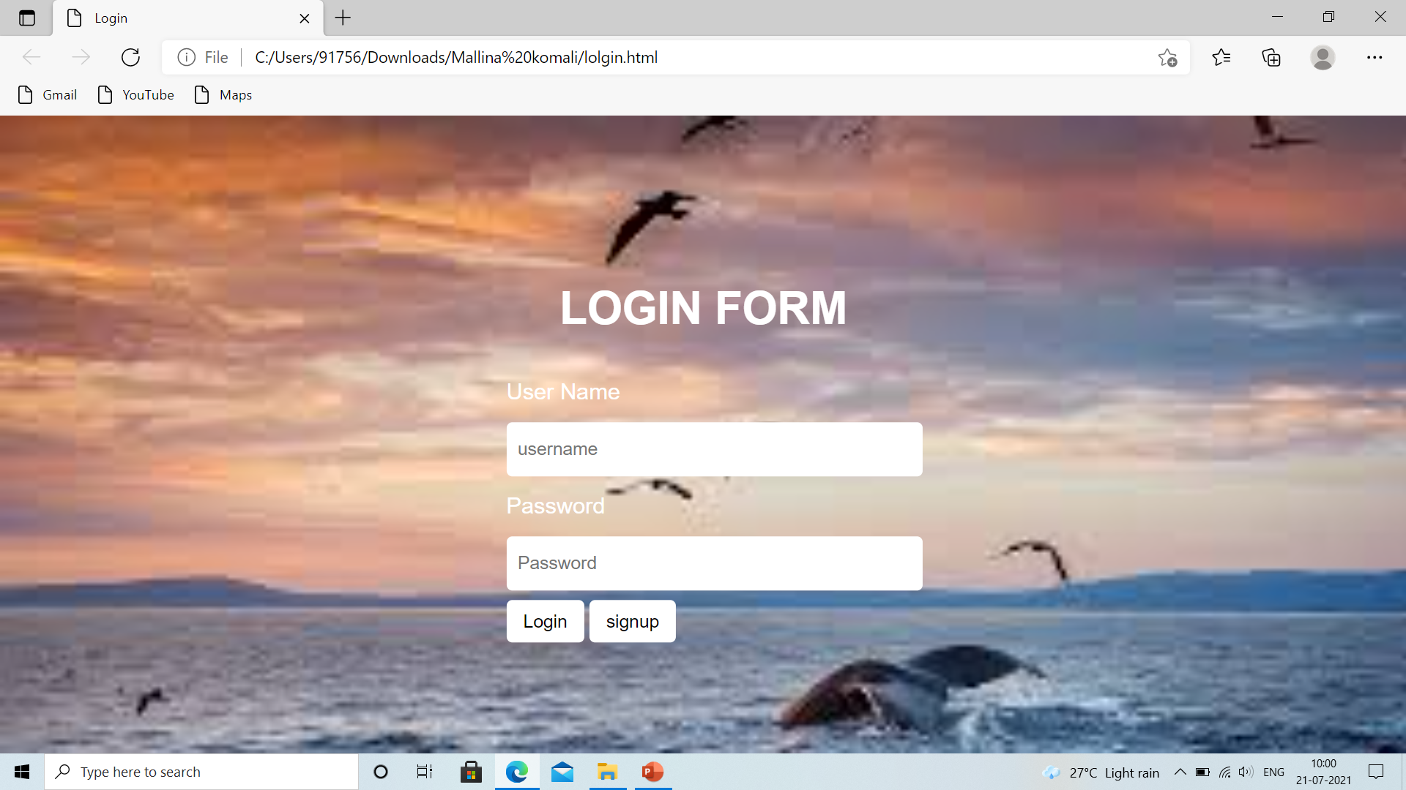
Screen shot of login-page

Slide 7
Benefits to Online shopping
Usability and easy access
Better deals and savings rewards
Low price and good quality
We can return the product if we don’t like
Product Reviews
Saves Time
Comparison Shopping

Slide 8
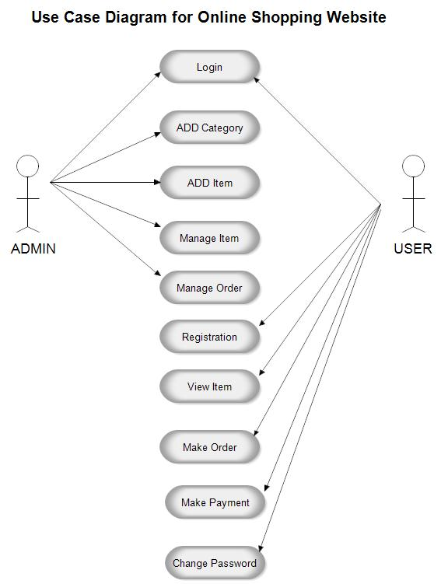
USE CASE DIAGRAM

Slide 9
conclusion
Protecting yourself can make shopping online easy and beneficial to all involved
Online shopping is the best way to purchase any item in the store
Being able to buy any time , any place , anywhere.
Online shopping become more enjoyable and easier than real-world shopping
But online shopping has a great future but to be successful it is necessary to spread awareness about its benefit.

Slide 10


